Slide 1

Microsoft Stock Price Prediction Using Stacked LSTM
A predictive model analysis (2014-2024)
By Udochi Ogbonna

Slide 2
Introduction
This project uses a Stacked Long Short-Term Memory (LSTM) model to predict the stock price of Microsoft (MSFT) from January 2014 to October 2024, with a forecast for the next 30 days.
This is not for investment purpose

Slide 3
Data Preparation
Data Source: Historical stock prices of MSFT from January 2014 to October 17, 2024 was obtained from yfinance using some snippets code.
Feature Selection: The Close column was selected for analysis and chart plotted
Data is normalized using MinMaxScaler and split into sequences suitable for LSTM input
Train-Test split ensures model generalization

Slide 4
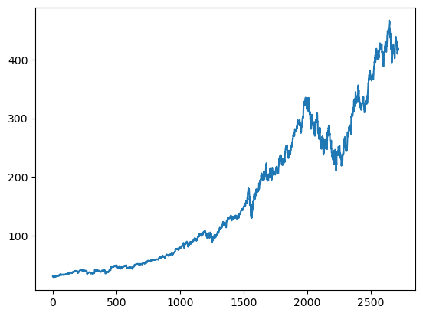
MSFT CHART

Slide 5
Model Architecture
Stacked LSTM model with multiple LSTM layers
Dropout layers added to prevent overfitting
Reduced learning rate were applied to prevent overfitting.
Model trained to predict future stock prices based on past trends

Slide 6
Prediction Results
RMSE on training data:6.72
RMSE on testing data: 18.03
The model predicts a slight drop in MSFT prices for the next 30 days

Slide 7
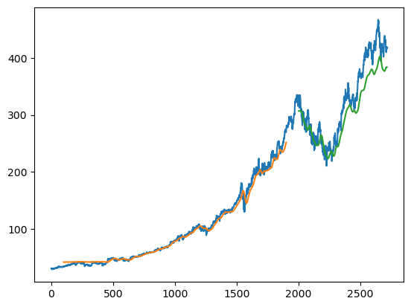
Train/Test chart

Slide 8
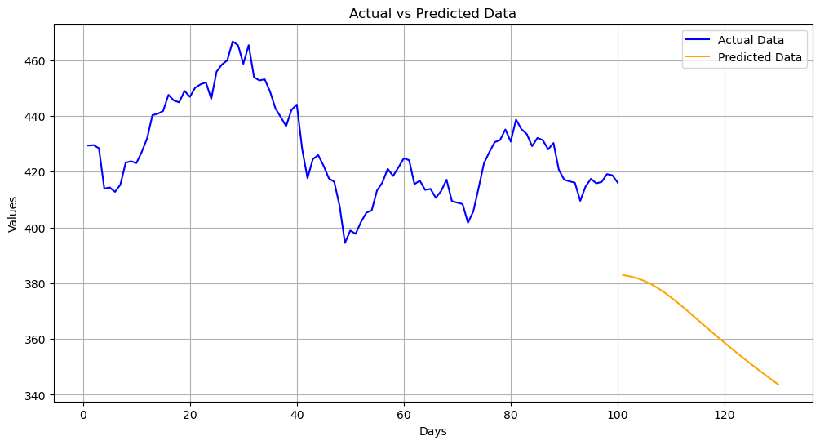
Forecast Sheet
The model predicts a slight significant drop in MSFT prices for the next 30 days

Slide 9
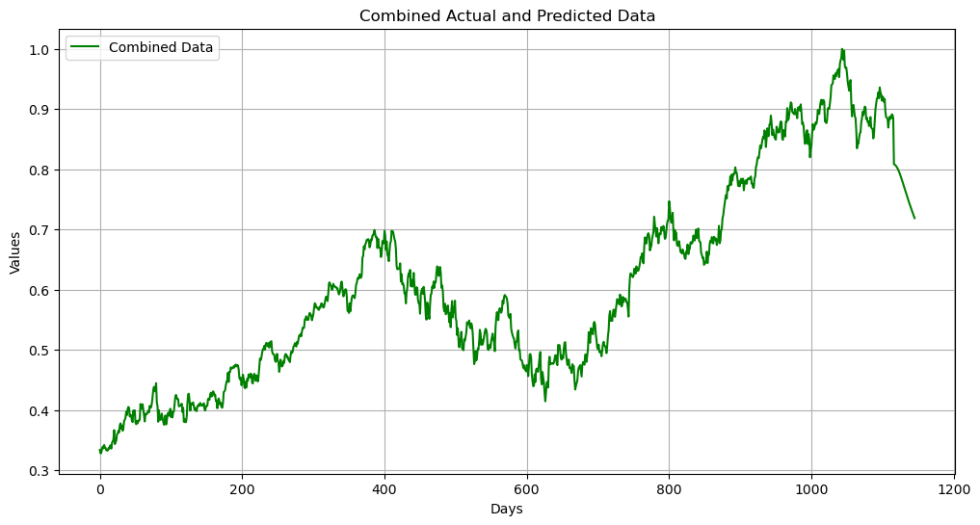
Forecast Chart

Slide 10
Conclusion
Stacked LSTM models are highly effective in capturing long-term dependencies in time series data.
Predicts future market trends, with proper regularization to prevent overfitting.
Next 30 days forecast shows a slight decline in Microsoft stock prices (October 18, 2024 – November 18, 2024).

Slide 11
Future Work
Model Tuning: Further hyperparameter optimization can improve the accuracy of the model.
Feature Engineering: Incorporating additional features (e.g., market sentiment, trading volume) could enhance predictive performance.
Other Stocks: Extending this methodology to other stocks or assets can help test the model's versatility.

Slide 12
Thank you.

